Slide 1
Exploration of System Calls using Linux
In Linux, system calls are the fundamental interface between user programs and the Linux kernel.

Slide 2
What is a System Call?
Interface between user and kernel
A system call is a way for a user program (like a C program) to request a service from the operating system kernel.

Slide 3
Types of System Calls
Process control
File Management
Information Management

Slide 4
Process Control System Calls
fork() – create a new process
exec() / execl() – execute a new program
wait() – wait for child process
exit() – terminate process

Slide 5
File Management System Calls
open() – open a file
read() – read from file
write() – write to file
close() – close a file

Slide 6
Information Management
Getpid() – get process ID
Getppid() – get parent process ID

Slide 7
Program :
#include <stdio.h> // printf(), perror()
#include <unistd.h> // fork(), execl(), getpid(), getppid()
#include <sys/wait.h> // wait()
int main() {
pid_t pid;
pid = fork();
if (pid == -1) {
perror("fork");
return 1;
}
else if (pid == 0) {
// Child process
printf("Child Process\n");
printf("Child PID : %d\n", getpid());
printf("Parent PID : %d\n", getppid());
execl("/bin/ls", "ls", "-l", NULL);
}
else {
// Parent process
printf("Parent Process\n");
printf("Parent PID : %d\n", getpid());
printf("Child PID : %d\n", pid);
wait(NULL);
printf("Child process finished\n");
}
return 0;
}

Slide 8
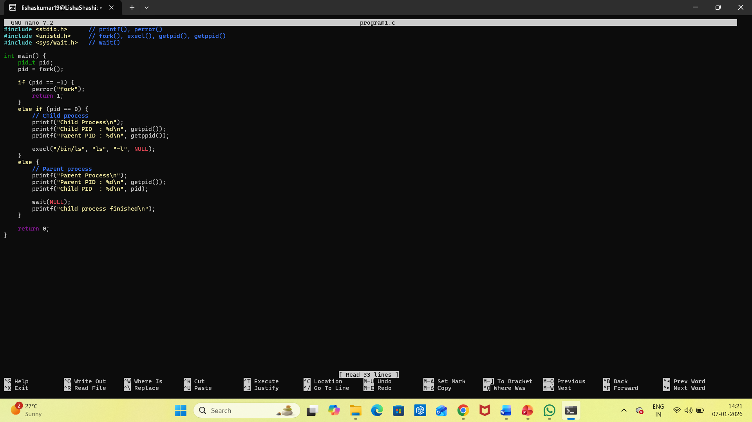

Slide 9
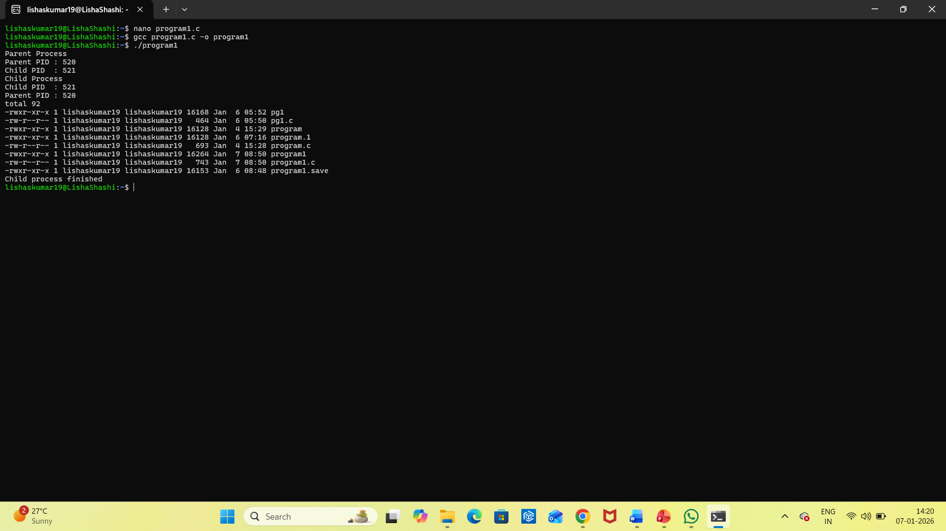

Slide 10
Conclusion
System calls enable secure OS operations

